Slide 1
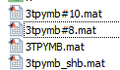
Add er name A1
Read from a mgr. file
Save to a mgr. file
Delete
User 1
1. Ask getting er with name A2
Material Manager
2. Find er
er (permittivity)
3. Return the 1st object in A2
A1
All the nk file related to 3TPYMB (an organic material) can be added with the same alias called 3TPYMB.
A2
A3
Intrinsic spectrum
Switch
B1
B2
Dipole orientation factors
Here we set the file called “3TPYMB.mat” in the first place. As a result, when the user want the permittivity of 3TPYMB, the material manager system would return the permittivity value in file “3TPYMB.mat”.
C1
Name
Data

Slide 2
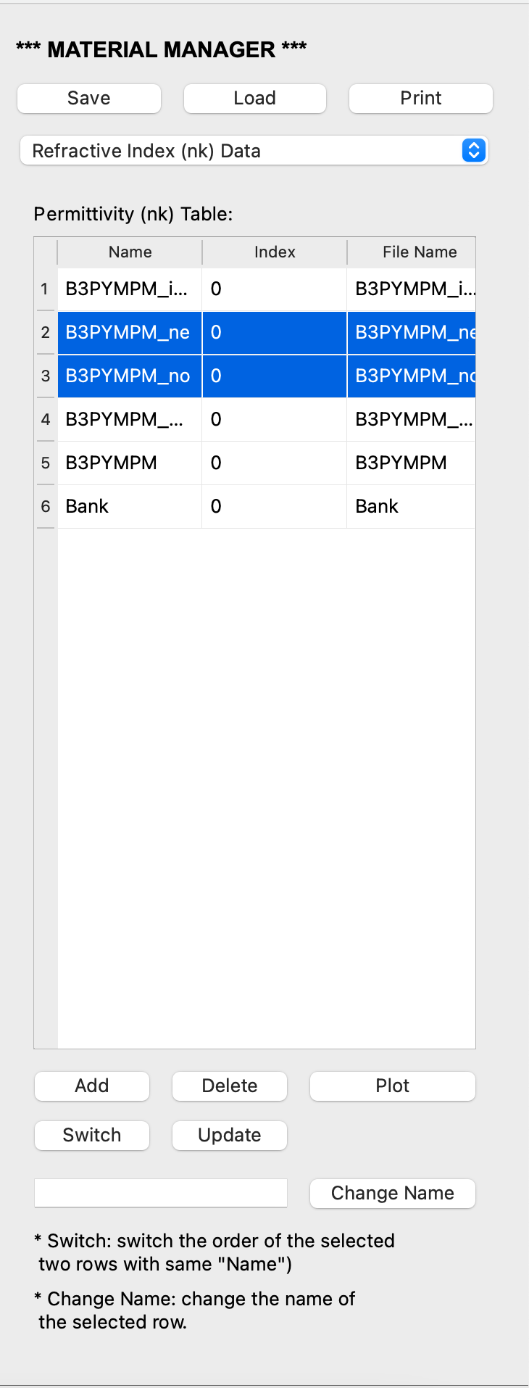
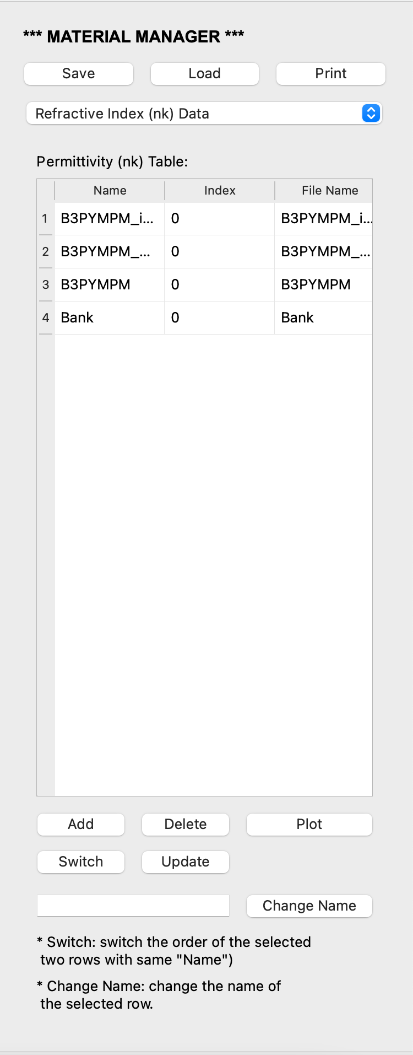
Select deleted file(s)
After delete

Slide 3
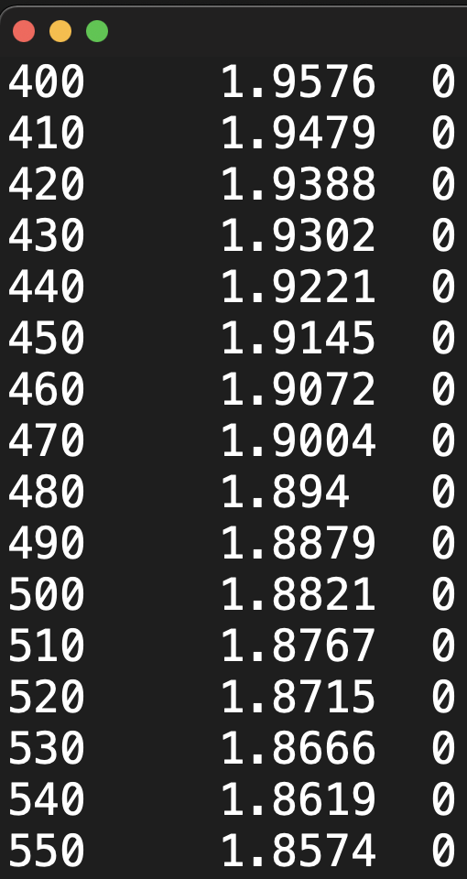
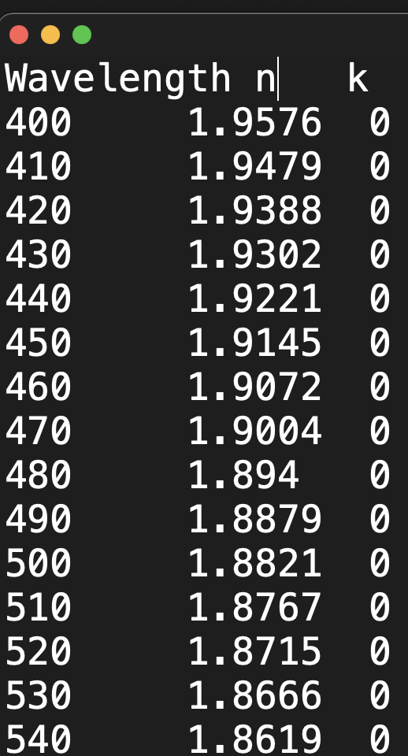

Slide 4
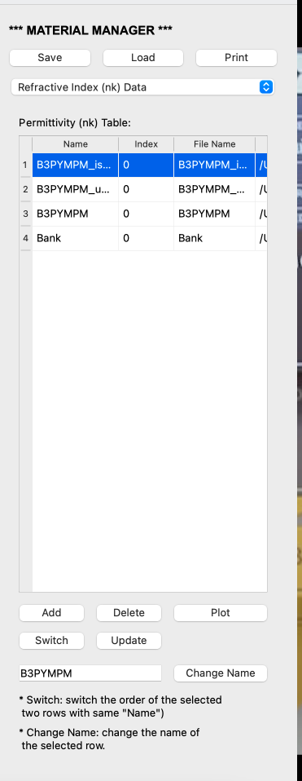
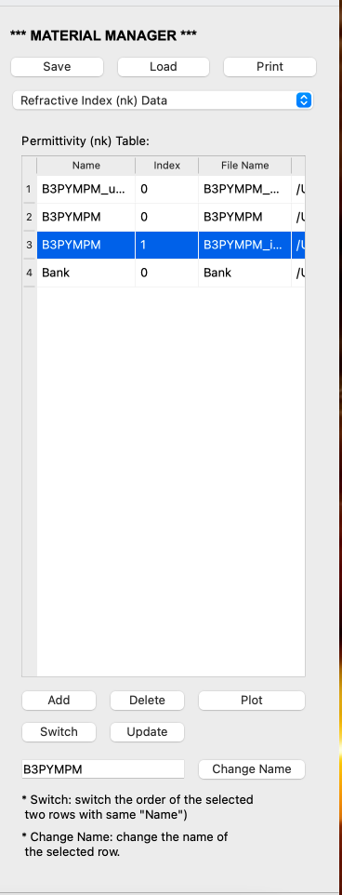
Select file and type the alias
After change the alias

Slide 5
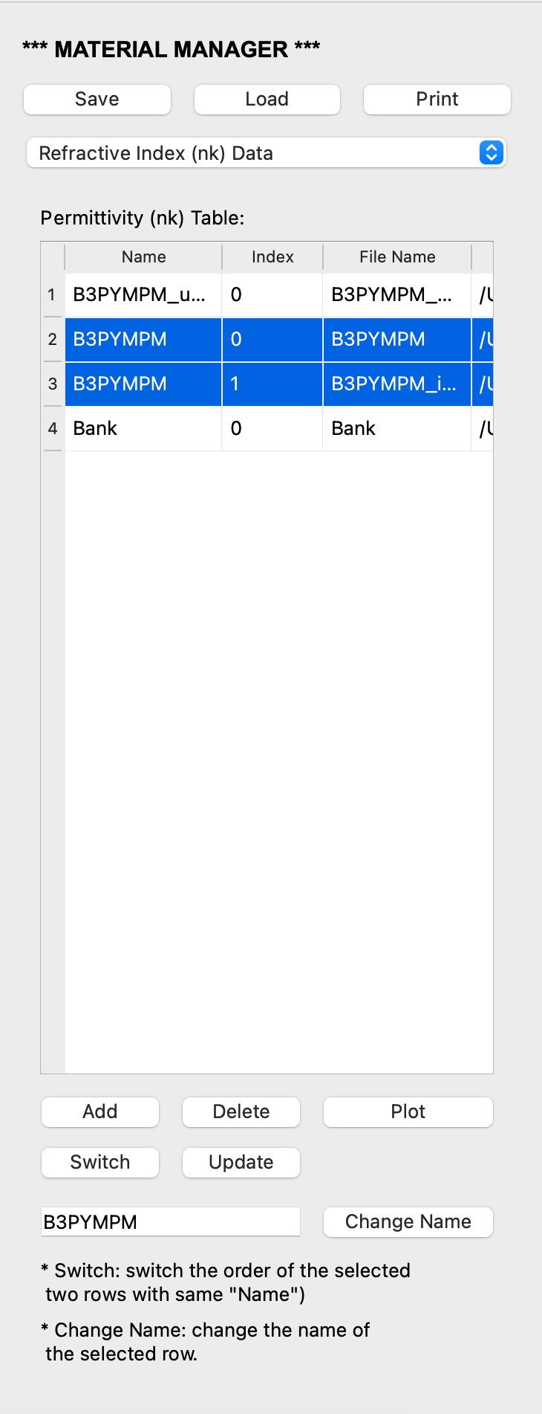
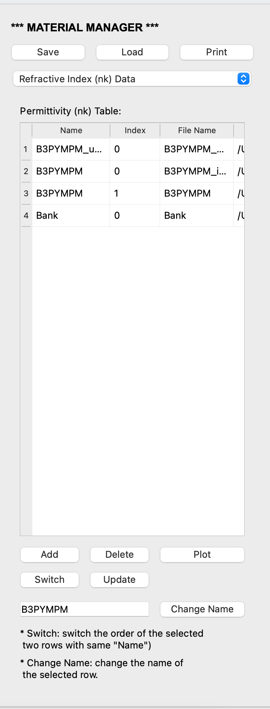
Select two materials with same name
After switch two materials

Slide 6
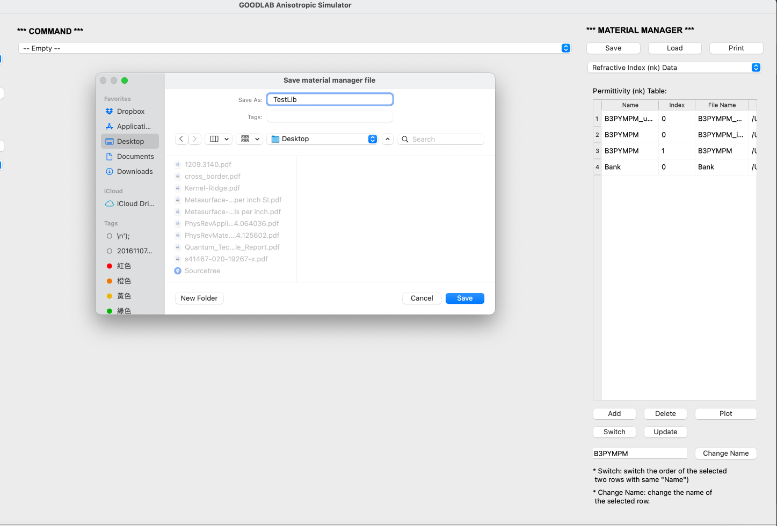

Slide 7
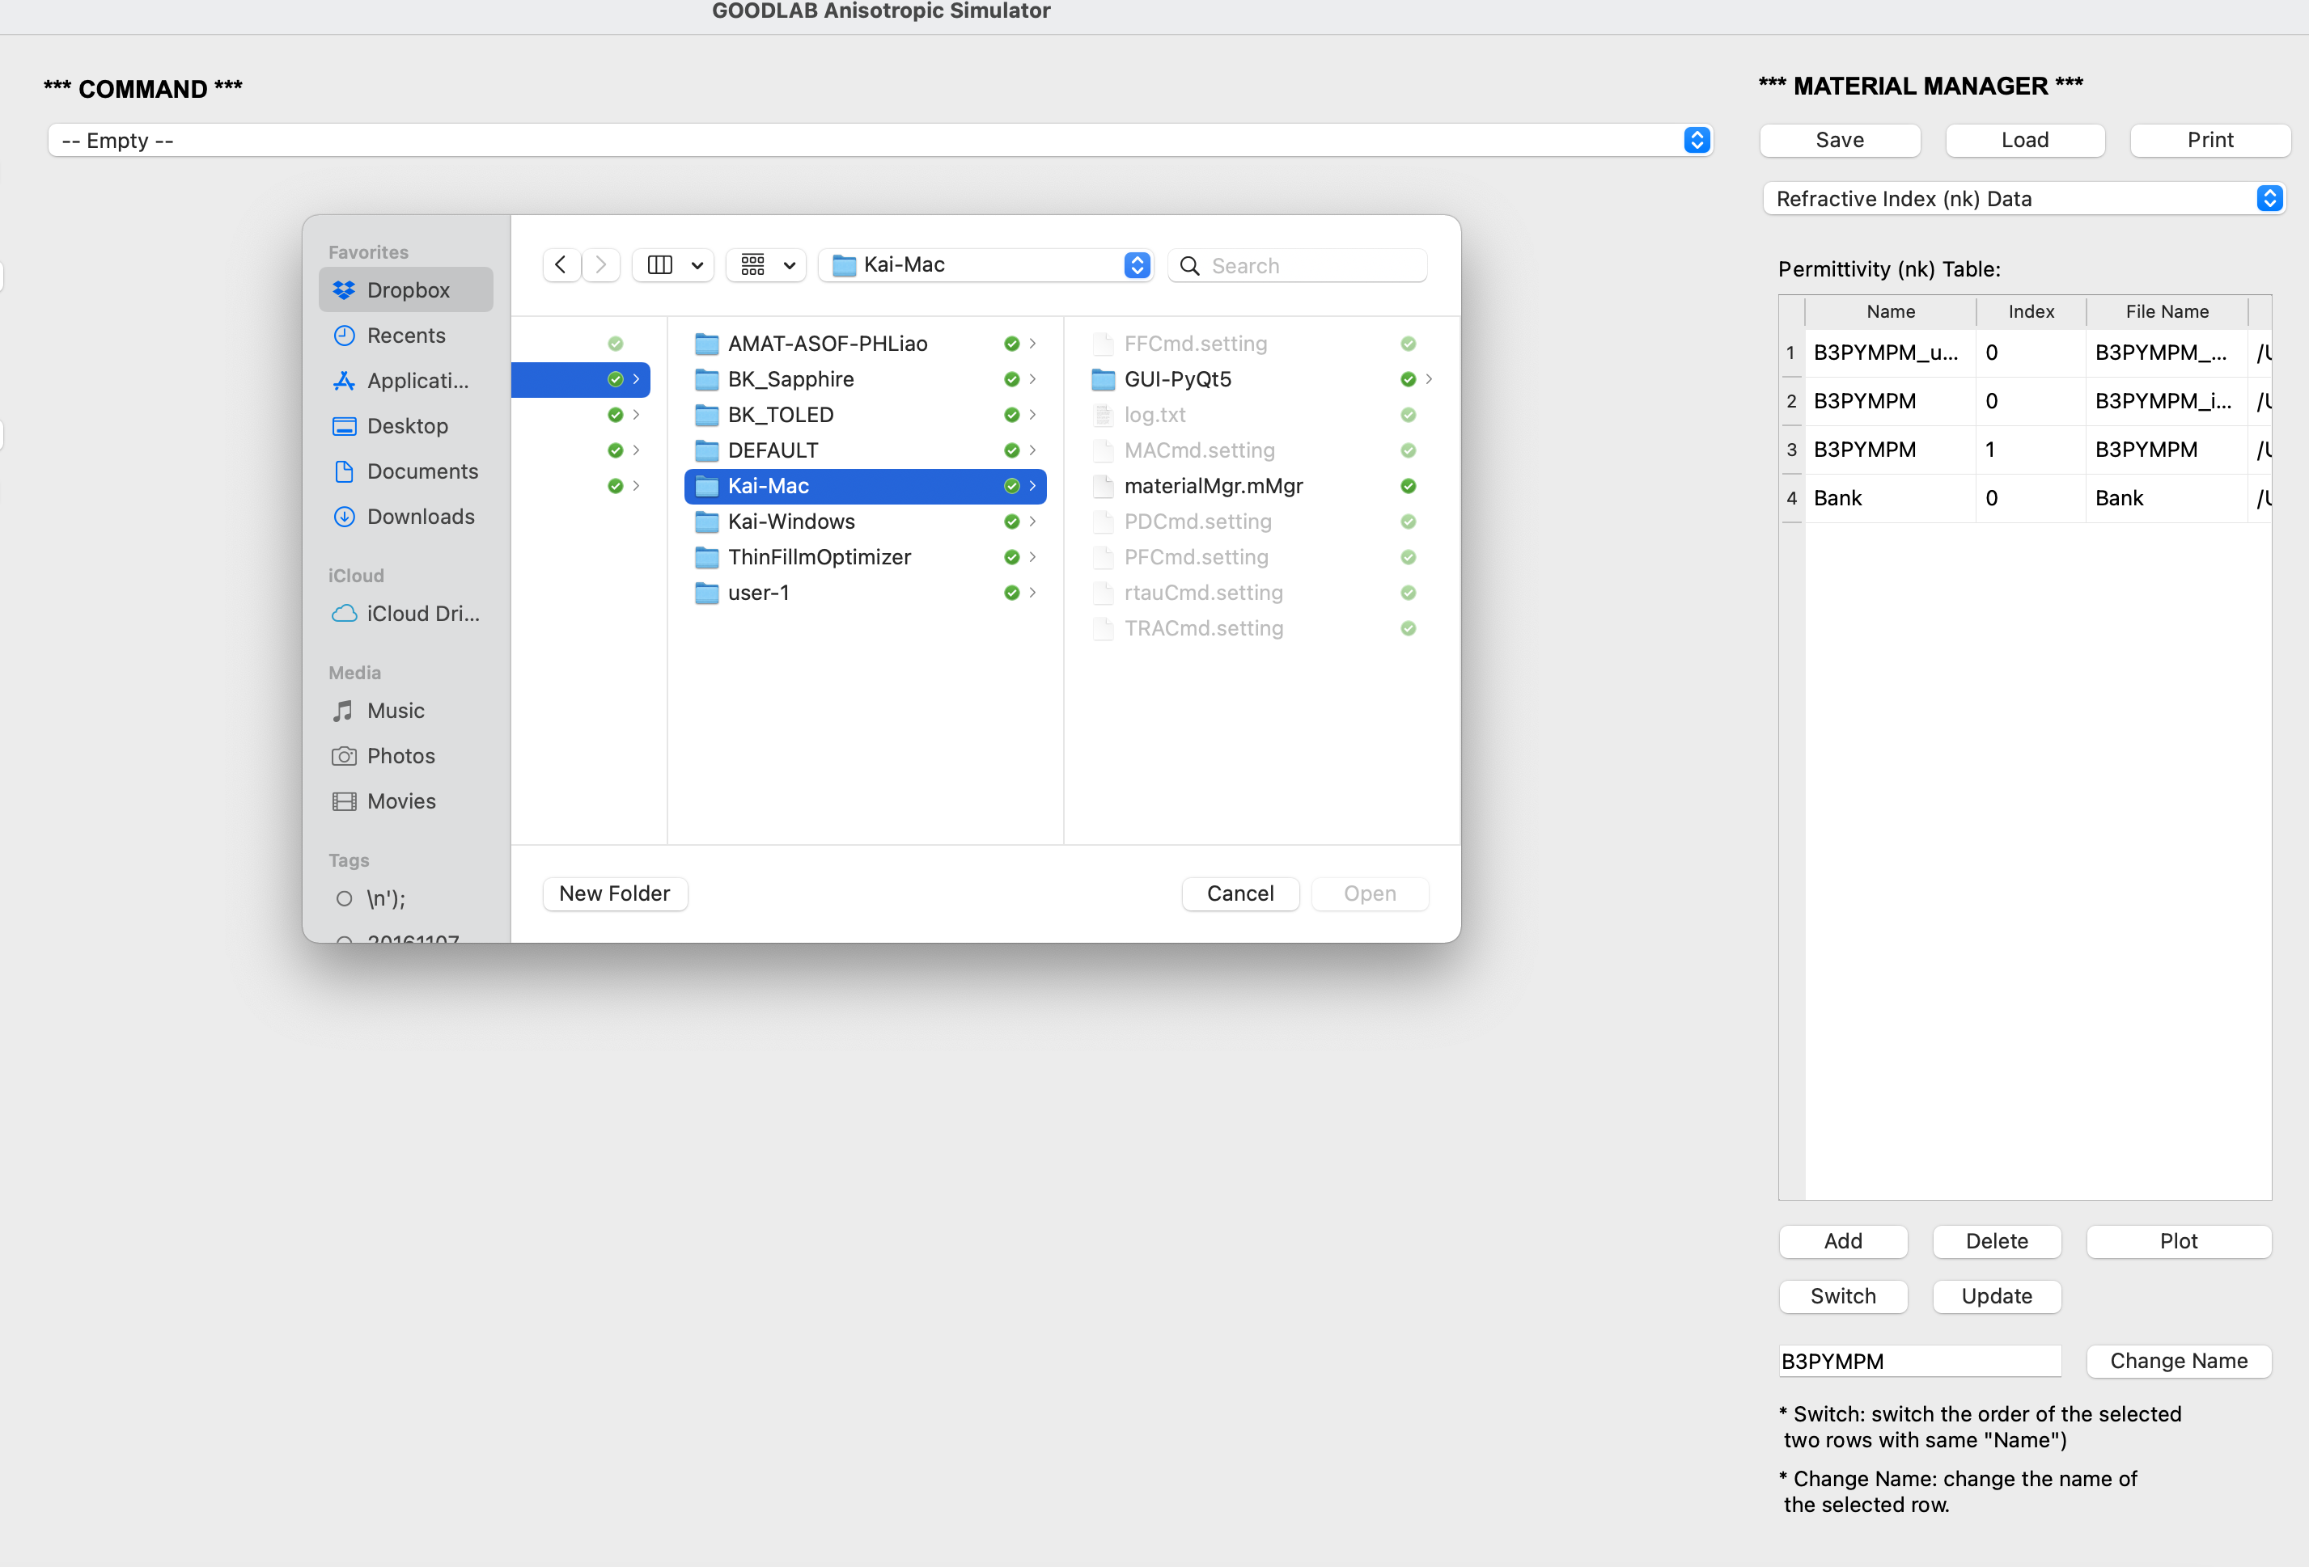
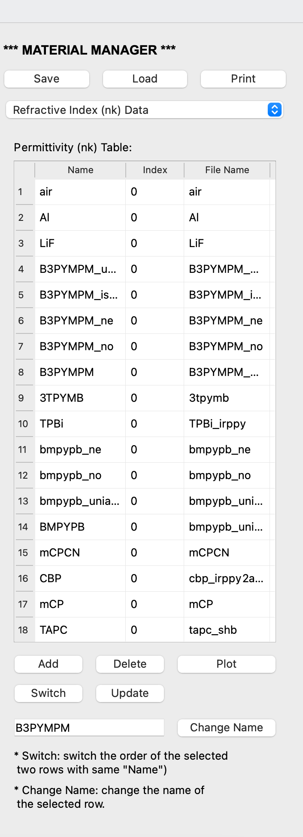
Load new material manager
After loading

Slide 8
